Slide 1

Suicide Factors
Dallas Gold
Imamah Younus
Meagan Heine
Chris Henderson

Slide 2

What is Suicide?
CDC defines suicide as death caused by self-directed injurious behavior with an intent to die as a result of the behavior.
Suicide attempt- A non-fatal, self-directed, potentially injurious behavior with an intent to die as a result of the behavior; might not result in injury.

Slide 3
Datasets Used
World Suicide Statistics 1985 – 2016 (World Health Organization, Kaggle.com)
Freedom of the World Index (Freedom House, Kaggle.com)
World Development Indicators (The World Bank, Kaggle.com)
Instagram Data (Napoleancat.com)
Google Trends Search Data
Gun Ownership Statistics by State (Demographicdata.org)

Slide 4
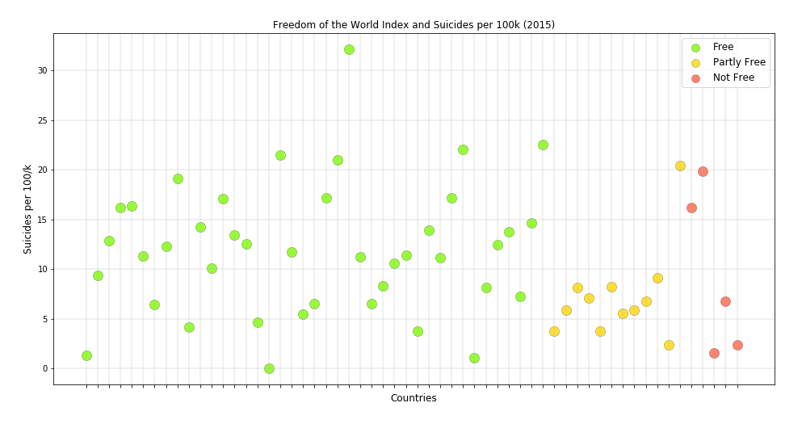
Freedom of the World Index
Developed by the Freedom House
A combination of political rights and civil liberties

Slide 5
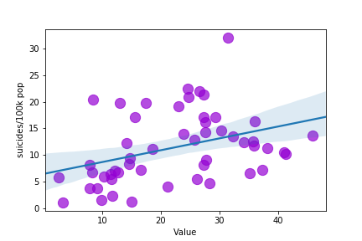
Broadband Internet

Slide 6
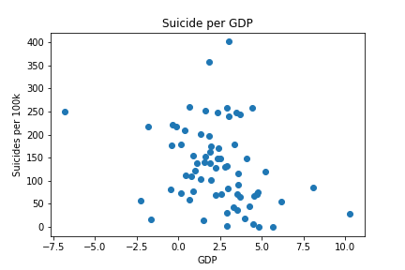
GDP

Slide 7
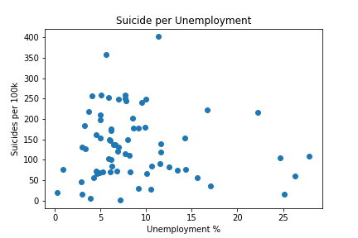
Unemployment

Slide 8
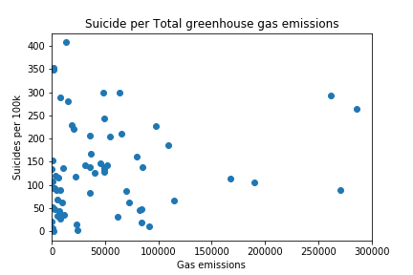
Greenhouse Gases

Slide 9
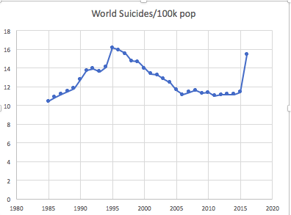
From the Suicides and Country Dataset
Notes:
Average is about 12.6

Slide 10
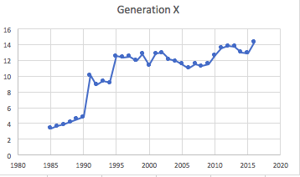
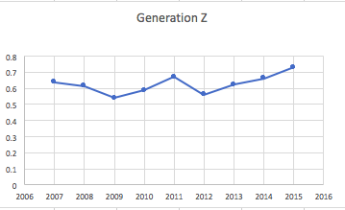
Different Generations
Notes:
Generation X 10.51
Generation Z .626
Gen X: Gen X was born between 1965 - 1979 and are currently between 39-53 years old (82 million people in U.S.)
Gen Z: Gen Z is the newest generation to be named and were born between 1995 and 2015. They are currently between 3-23 years old (nearly 74 million in U.S.)

Slide 11
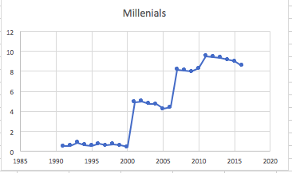
Our Generation
Notes:
Millennials 4.69
Gen Y: Gen Y, or Millennials, were born between 1980 and 1994. They are currently between 24-38 years old.
Gen Y.1 = 24-28 years old (31 million people in U.S.)
Gen Y.2 = 28-38 (42 million peeps)

Slide 12
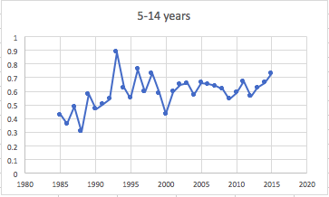
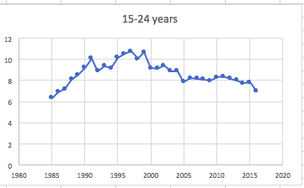
Different Age Groups
Notes:
5-14 years .5946
15-24 years 8.66

Slide 13
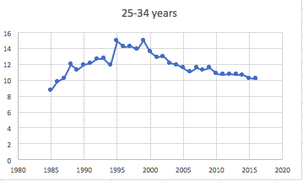
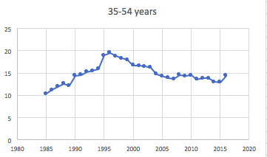
Age Groups continued..
Notes:
25-34 years 11.86
35-54 years 14.82

Slide 14
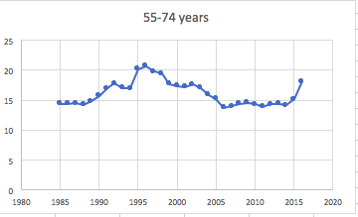
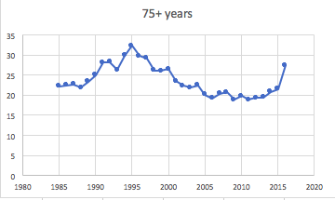
Age Groups continued..
Notes:
55-74 years 16.11
75+ years 23.65

Slide 15
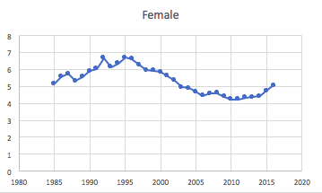
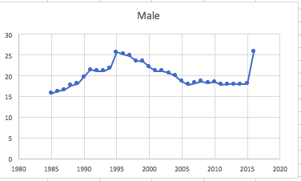
Female/Males
Notes:
Female 5.33
Male 20.06

Slide 16
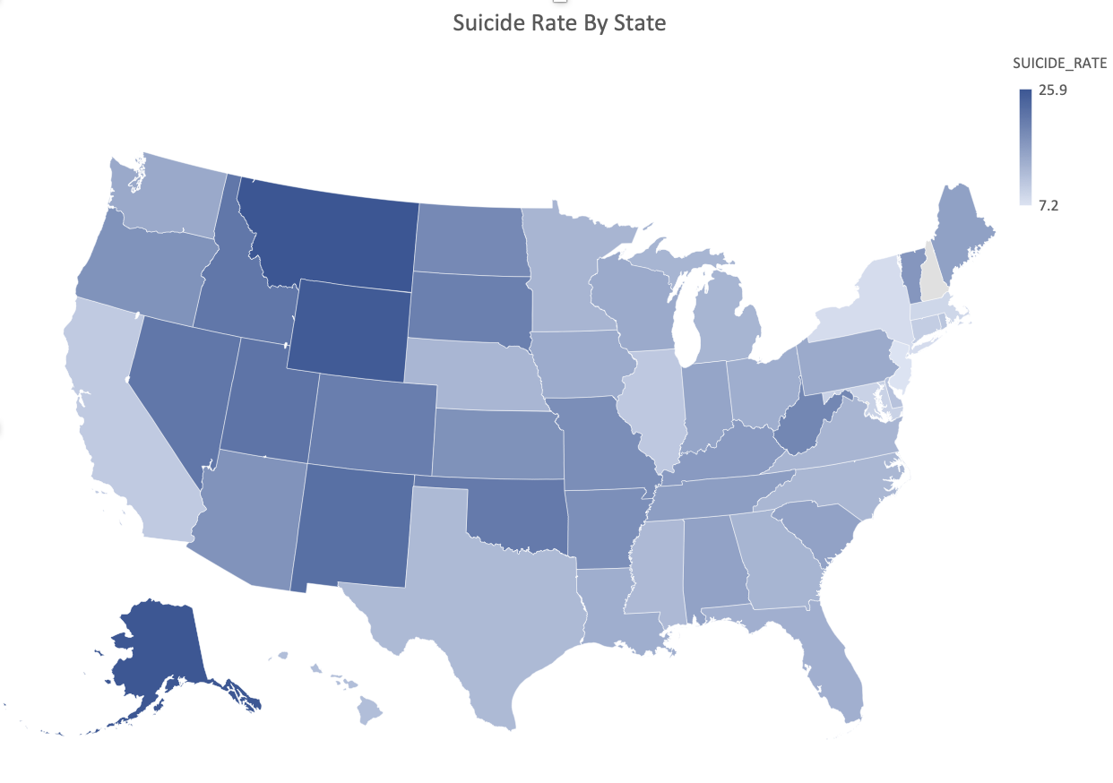
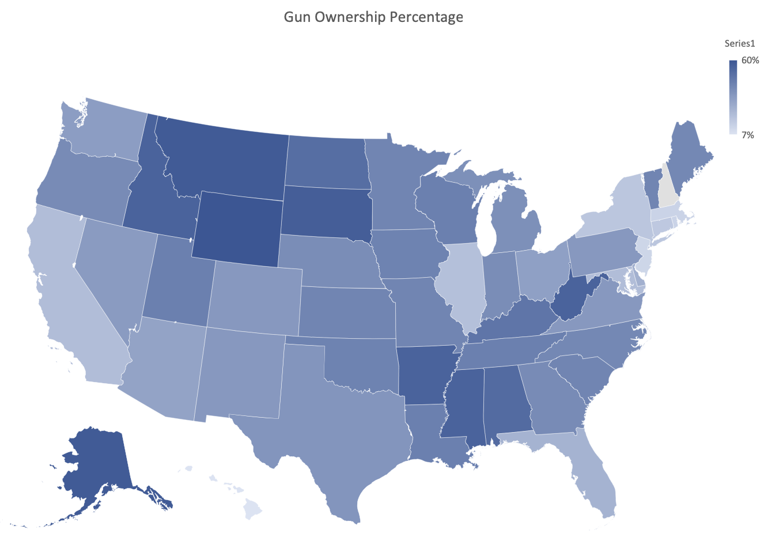
Gun Ownership

Slide 17
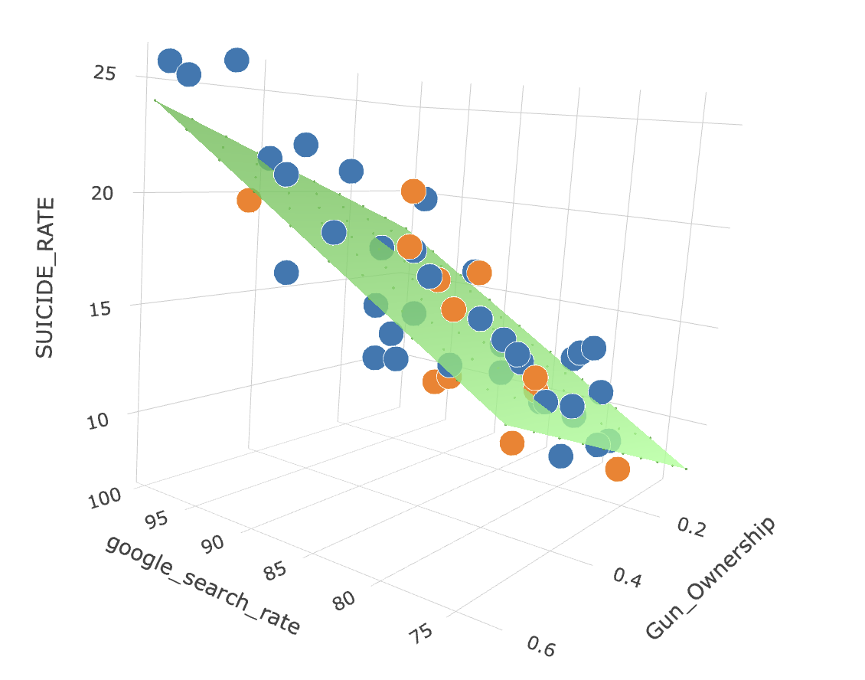
Gun Ownership

